Slide 1


Engs 28
Embedded Systems
Day 17x

Slide 2
Agenda
Sleep modes / Watchdog timer
Other popular microcontrollers
Project work time

Slide 3
Power Management (Sleep Modes)
Reference Manual, Ch 4

Slide 4
Where does the power go?
The microcontroller circuits are made of transistors, acting as switches.
Even when a transistor is “off”, a tiny amount of current “leaks” through it, from V_{CC} to ground — static power consumption.
To switch a transistor from off to on, or from on to off, a tiny capacitance must be charged or discharged — dynamic power consumption.
Dynamic power is proportional to clock frequency.
Dynamic power of the Cortex-M0+ core ranges from 5 to 50µW/MHz depending on the technology used.
To reduce power consumption, use the right sleep modes and turn off unneeded peripherals and clock signals during sleep.
The deeper the sleep the longer it can take to restore the system to operation state after exiting sleep mode.
Notes:
The dynamic power consumption of a CMOS IC is calculated by adding the transient power consumption, and capacitive-load power consumption.
Transient power consumption is due to the current that flows only when the transistors of the devices are switching from one logic state to another. This is a result of the current required to charge the internal nodes (switching current) plus the through current (current that flows from VCC to GND when the p-channel transistor and n-channel transistor turn on briefly at the same time during the logic transition).
Additional power (capacitive-load) is consumed in charging external load capacitance and is dependent on switching frequency.

Slide 5
Saving Power
Only enable those internal peripherals (such as SPI, UART, ADC, timers, etc.) that you are actually using, disable when done.
Run the processor at the lowest clock speed you can.
Let the processor sleep when it has nothing to do:
The Cortex-M0+ has built-in, low-power features that allow developers to optimize power usage for specific applications.
Look at the datasheets of all components you are using, run tests at different clock frequencies.
Upshot: For low power consumption, disable anything you don't need.

Slide 6
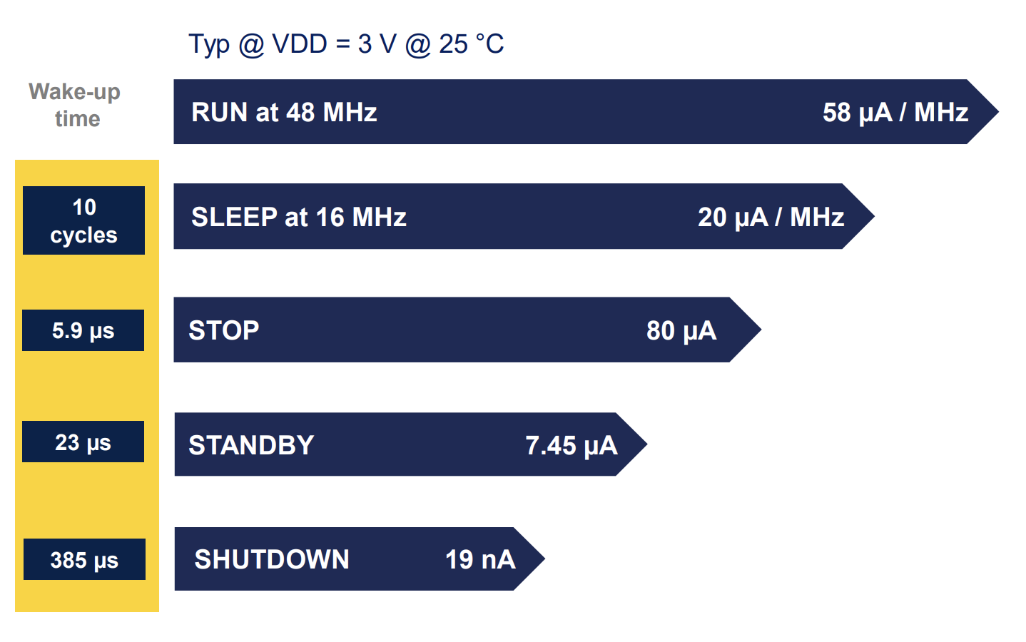
Power Saving Modes on the STM32C0

Slide 7
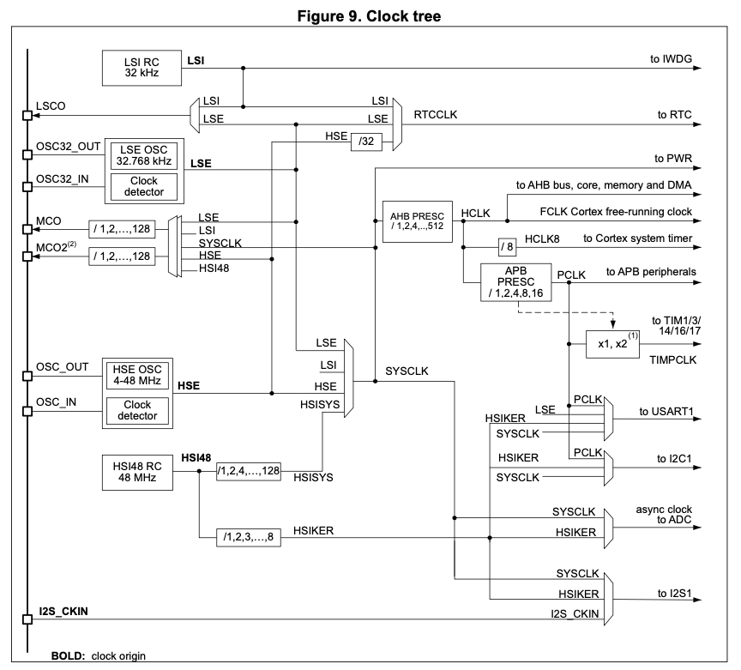
Clock distribution in the STM32C0
Lots of different “clock domains” inside the STM32C0.
Stopping a clock disables the corresponding domain, saving power.
/8
Notes:
This is the clock we have been using. There are lots of other possible clock sources that can produce primary clocks:
• HSI48 RC - a high-speed fully-integrated RC oscillator producing HSI48 clock (48 MHz), divided down by 8 by upon reset. "Our clock".
• HSE OSC - a high-speed oscillator with external crystal/ceramic resonator or external clock source, producing HSE clock (4 to 48 MHz)
• LSI RC - a low-speed fully-integrated RC oscillator producing LSI clock (about 32 kHz)
• LSE OSC - a low-speed oscillator with external crystal/ceramic resonator or external clock source, producing LSE clock (accurate 32.768 kHz or external clock up to 1 MHz)
• I2S_CKIN - pin for direct clock input for I2S1 peripheral

Slide 8
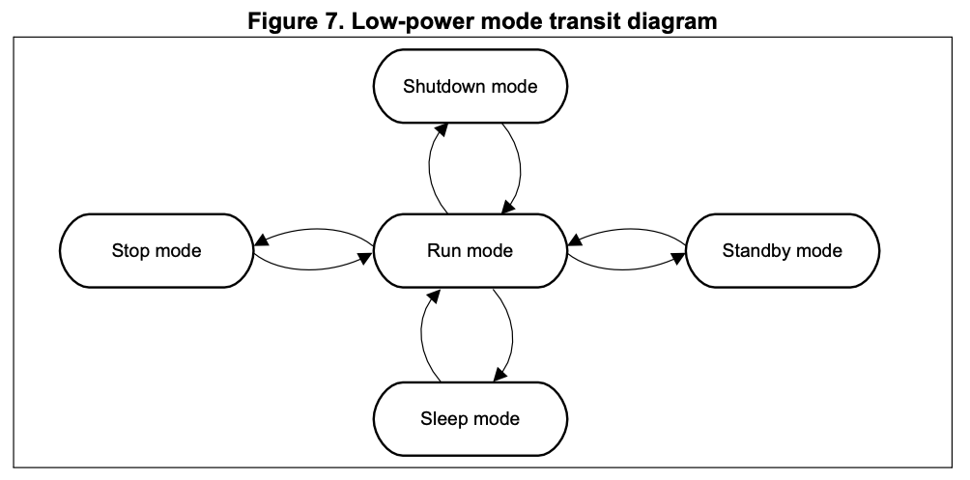
Power Control: Operating Modes

Slide 9
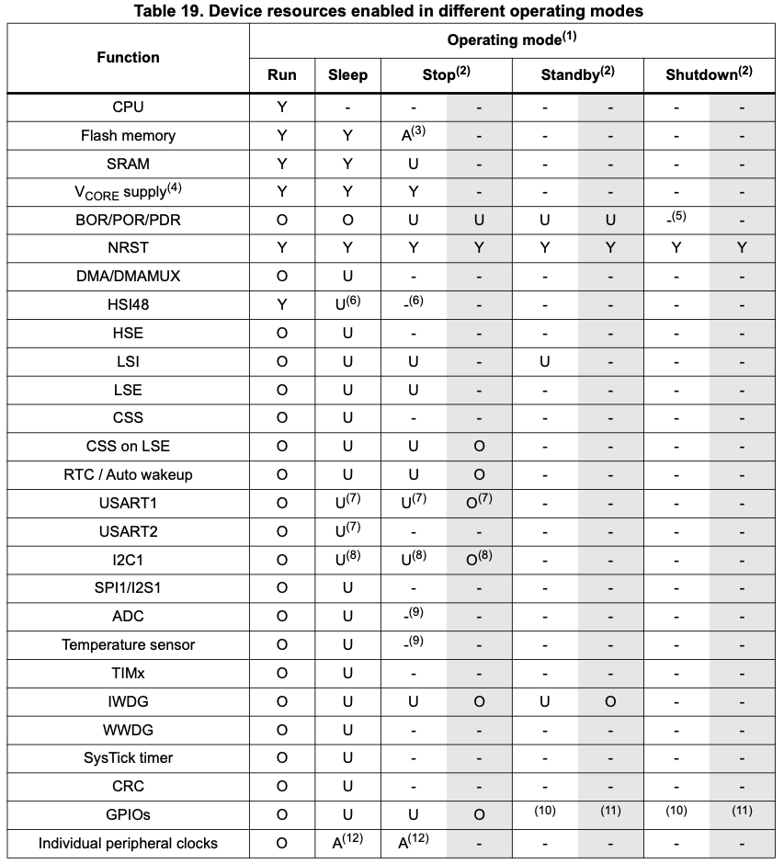
Device resources available in each operating
mode and their capability to wake the device up from a low-power mode to Run mode.

Slide 10
Sleep mode
CPU clock off
all peripherals can run and wake up the CPU
peripheral clocks can be disabled prior to going to sleep
HSI48 can be restarted by a peripheral with wakeup capability requiring HSI48
Stop mode
SRAM and register contents are retained. HSE and HSI48 stop.
HSI48 can be restarted by a peripheral with wakeup capability requiring HSI48.
The event of exiting Stop mode enables the HSI48 oscillator and selects HSISYS as system clock
Standby mode
VCORE domain powered off
SRAM and register contents lost except PWR control register 3
All clocks in VCORE domain stopped, HSI48 and HSE disabled
Exiting Standby mode enables the HSI48 oscillator, selects HSISYS as system clock.
Shutdown mode
VCORE domain powered off
SRAM and register contents lost.
All oscillators disabled.
Exiting Shutdown mode enables the HSI48 oscillator, selects HSISYS as system clock.

Slide 11
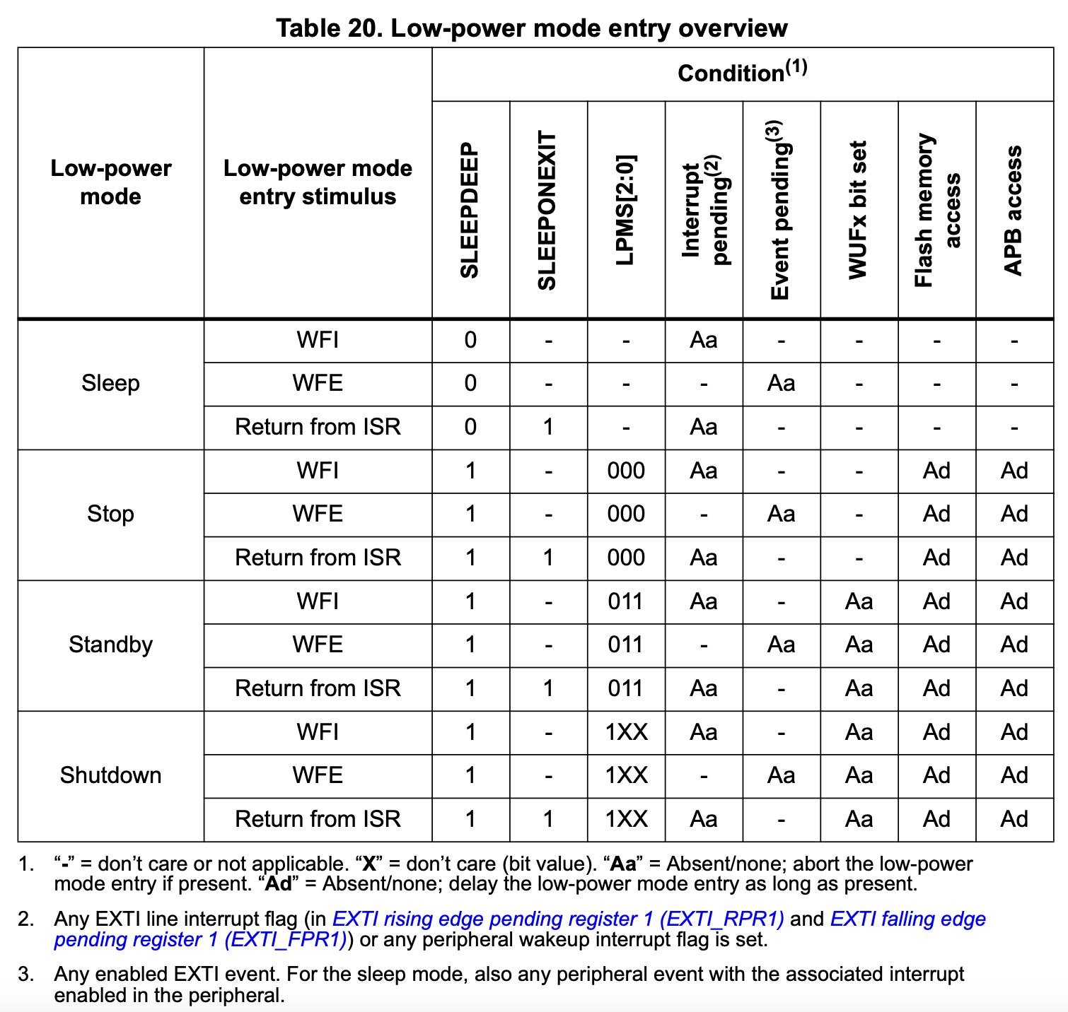
Entering low-power modes.
WFI = wait for interrupt
WFE = wait for event

Slide 12
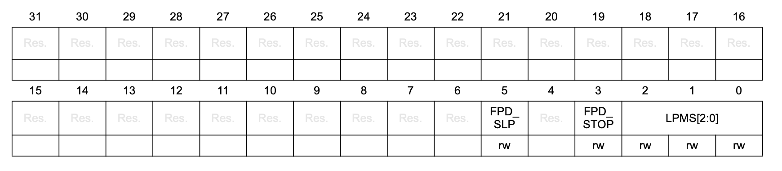
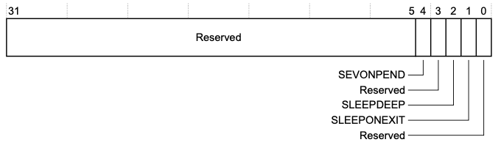
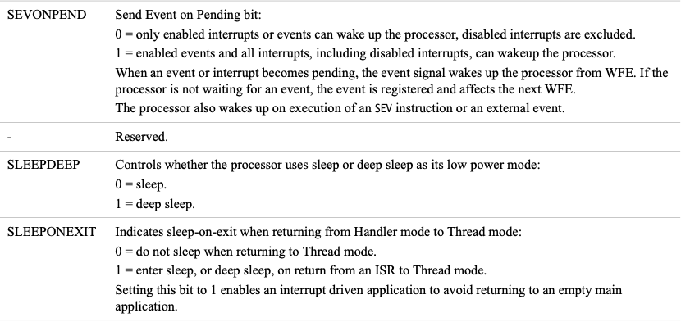
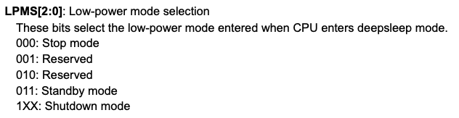
PWR control register 1 (PWR_CR1)
Table 20 in reference manual
The selection of the low-power mode to enter is determined by the SLEEPDEEP and LPMS[2:0] bitfields.
System Control Register (SCR)
Table 4-14 in cortex m0+ generic user guide

Slide 13
Programming a sleep mode
To put the processor to sleep:
Set the LPMS[2:0] bitfield to the desired mode.
Set the SLEEPDEEP bits to the desired mode.
Execute the desired low-power mode instruction:
WFI (wait for interrupt)
WFE (wait for event)
#include <ES28.h>
⋮
PWR->CR1 |= (PWR_CR1_LPMS0 | PWR_CR1_LPMS1); //stop mode
SCB->SCR |= SCB_SCR_SLEEPDEEP_Msk;
__WFI();
To wake the processor up:
An appropriate interrupt occurs.
Reset LPMS and SLEEPDEEP bits
Get back to work!
Notes:
void sleep_cpu ( void )
Put the device into sleep mode. The SE bit must be set beforehand, and it is recommended to clear it afterwards.

Slide 14
Processing loop with sleep
int main(void) {
// Initialize devices, enable interrupts
...
while(1) {
// Check interrupt flags, take action
...
// Go to sleep, await the next interrupt
__WFI();
// When CPU wakes up, execution resumes at the top of the loop.
}
}
// ISRs (including at least one interrupt that awakens the processor!)
...

Slide 15
Watchdogs
Reference Manual:
Section 20: Independent watchdog (IWDG)
Section 21: System window watchdog (WWDG)

Slide 16

What does the watchdog do?
Independent Watchdog (IWDG): timer that runs on a 32 kHz (slow!) internal clock that is independent of the main clock. 12-bit downcounter with an 8-bit prescaler.
A healthy program resets the watchdog often (“pet the dog”).
If the program gets stuck, or an expected event does not occur in time, the watchdog will time out and reset the processor.
The IWDG also has a "window" option that allows petting the dog only during a specified window in the countdown process: petting too early or too late will generate a reset.
There is another watchdog, the system window watchdog, that runs on the main clock, can generate early interrupts before a reset occurs and is a bit more flexible.
Notes:
A watchdog timer (WDT) is a timer that monitors microcontroller programs to see if they are out of control or have stopped operating. It acts as a “watchdog” watching over MCU operation.
The IWDG protects you from the system dying: protects from clock failure, memory bits accidentally changing, deep system lockups. A hardware-level safety net. Keeps running even if the system clock fails.
The WWDG protects you from the system misbehaving: unexpected execution speed (too fast - skipped code - or too slow - runaway code). More about runtime behavior. Depends on system clock being functional.
When the independent watchdog is started by writing the value 0x0000 CCCC in the IWDG key register (IWDG_KR), the counter starts counting down from the reset value of 0xFFF. When it reaches the end of count value (0x000) a reset signal is generated (IWDG reset). Whenever the key value 0x0000 AAAA is written in the IWDG key register (IWDG_KR), the IWDG_RLR value is reloaded in the counter and the watchdog reset is prevented. Once running, the IWDG cannot be stopped.
If the window watchdog is activated (the WDGA bit is set in the WWDG_CR register), and when the 7-bit down-counter (T[6:0] bits) is decremented from 0x40 to 0x3F (T6 becomes cleared), it initiates a reset. If the software reloads the counter while the counter is greater than the value stored in the window register, then a reset is generated. The application program must write in the WWDG_CR register at regular intervals during normal operation to prevent an MCU reset. This operation can take place only when the counter value is lower than or equal to the window register value, and higher than 0x3F. The value to be stored in the WWDG_CR register must be between 0xFF and 0xC0.
The IWDG is "petted" via a simple counter reset from somewhere in your program. The problem with this type of reset is what happens if the code that resets the IWDG is in the infinite loop that's crashed the code? The counter will be constantly reset but the CPU never restarts even though it isn't working.
The WWDG sets up a window with a minimum and maximum time between WWDG reset pulses. Clear the WWDG too soon (i.e. inside a loop as above) and it will force a reset. Same if the WWDG pulse is too late, resets the same as if the IWDG timed out. Both watchdogs are useful.

Slide 17
A Quick Example
Make a copy of your template project, call the copy "Watchdog". Download watchdog.c from Canvas and copy+paste it into your new project's source folder.
Compile and upload to your Nucleo as per usual. Open Coolterm.
You'll see a "Hello dog world" message in Coolterm that seems to repeat every 4 seconds.
Now press the blue user button repeatedly and observe what happens:
When you press the button more frequently than every 4 seconds,
When you press the button less frequently than every 4 seconds.

Slide 18
A Quick Example
What actually happens:
The "Hello dog world" message is a message printed at the very start of the program, before the event loop.
So seeing the message over and over means the device is rebooting regularly.
When you press the blue user button the program is "petting the watchdog", thereby resetting the countdown timer that ultimately would have resulted in a reboot.
If you pet the watchdog frequently enough the program will continue running without rebooting.

Slide 19
The Independent Watchdog (IWDG)
Configure the IWDG:
"Unlock" the protected prescaler and reload registers by writing 0x0000 5555 to the IWDG key register (IWDG_KR)
Set the counting rate using the prescaler (IWDG_PR)
Set from where to count down using the reload register (IWDG_RLR)
Start the IWDT
Write 0x0000 CCCC to the key register (IWDG_KR)
The counter starts counting down from the reset value.
When it reaches the end of count value (0x000) a reset signal is generated
Pet the dog:
Write 0x0000 AAAA to the IWDG key register (IWDG_KR),
The IWDG_RLR value is reloaded in the counter and the watchdog reset is prevented.
Once running, the IWDG cannot be stopped.

Slide 20
#include "ES28.h"
#include "uart.h"
#include <stdio.h>
// A few magic numbers for the watchdog (from the datasheet)
#define KEY_ACCESS 0x00005555
#define KEY_UPDATE 0x0000AAAA
#define KEY_START 0x0000CCCC
int main( void ) {
uart2_init();
printf( "Hello dog world\r\n");
// Use the built-in blue user button as a proxy for petting the dog.
RCC->IOPENR |= RCC_IOPENR_GPIOCEN;
GPIOC->MODER = (GPIOC->MODER & ~GPIO_MODER_MODE13_Msk) | (GPIO_INPUT << GPIO_MODER_MODE13_Pos);
// The watchdog is always accessible, so no need to turn any clocks on for it.
// First, unlock the watchdog registers by writing a special value to the key register
IWDG->KR = KEY_ACCESS;
// Set up the prescaler - the watchdog clock runs at 32KHz. We'll set up a 1ms tick.
while( IWDG->SR & IWDG_SR_PVU ); // Can only update when the PVU status bit is clear.
IWDG->PR = 0b011;
// Reload register is set to 4000: we need to pet the dog at least once every 4 secs
while( IWDG->SR & IWDG_SR_RVU ); // Can only update when the RVU status bit is clear
IWDG->RLR = 4000;
// Wake the dog...
IWDG->KR = KEY_START;
// Now, loop and pet the dog whenever the blue user button is pushed.
while(1){
if ( (GPIOC->IDR & GPIO_IDR_ID13) == 0 ){
// Pet the dog
IWDG->KR = KEY_UPDATE;
printf( "Nice Doggy\r\n");
delay_ms(100); // be nice to the terminal.
}
}
}

Slide 21

Super Quick Modification
Make the dog even needier: have it need a pet every 1 second
Make it even needier:
Add a printf() statement after the watchdog initialization but before the while loop (so before you get a chance to pet the dog)
How needy can you make it before it resets too fast to even print your message?

Slide 22
Choosing a microcontroller

Slide 23
Beyond the Arduino
Trends are toward faster 32-bit microcontrollers with more memory, etc., though for small projects, (smaller, cheaper, lower-power) 8-bit and 16-bit processors are often adequate, including:
Microchip AVR and PIC
Texas Instruments MSP430
ARM designs 32-bit processor architectures (M: microcontrollers, A: microprocessors). Other companies license and manufacture, including:
Microchip SAMD21 (ARM Cortex M0+) and SAMD52 (ARM Cortex M4)
STMicroelectronics (STM32)
Raspberry Pi (RP2040, Pico board)
Silicon Labs (EFM32 Gecko)
NXP
Espressif ESP32 uses a non-ARM architecture
Engs 62 uses an ARM Cortex-A9 processor.
Raspberry Pi uses 64-bit ARM Cortex-A53 (3B+) and A72 (4) processors. Not microcontrollers, but small computers (run Linux, etc).
Other small single-board computers include support for machine learning. “Edge computing”.
Notes:
Arduino is not the only game in town. In the hobby world it's the only game in town (in terms of getting people interested, having lots of fun, Adafruit and others sell a lot of stuff, etc).
You are not going to do major embedded systems work on an Arduino Uno.
If you want to do industrial stuff you need to up the game.
It's not that much more expensive. Trends are:
Having a microcontroller with 32-bit registers -> more complicated instruction sets, more complex calculations (Arduino: adding to 16-bit numbers takes several clock cycles since you have to break up each number into two 8-bit numbers etc).
For a 32-bit microcontroller the arithmetic unit is 32-bits wide, so can multiply two 32-bit numbers in hardware in one clock cycle.
That doesn't mean that smaller processors aren't useful (for example, the keypad on your dishwasher is probably handled by an 8-bit processor).
Competitor to the AVR is the PIC; now both are under the same company.
TI also has one.
Big dog these days in 32-bit processor design is ARM. They don't actually make chips: they design them and then license the design to companies that fabricate them. They are fabricated in Korea, Taiwan, etc.
Xilinx is fabless! They design and then the chips are fabricated elsewhere.
Cutting-edge fab stuff is happening just at a handful of companies.
But having a bunch of CAD stations and smart people is much cheaper.
ARM designs 32-bit and 64-bit architectures. The M0 and M4 are the most commonly seen architectures.
You can go out and buy microcontroller chips that are based on these architectures from multiple vendors. They are all based on the same architecture but differ in some other details. You have to look at those differences.
Microchip makes the SAMD21 (ARM M0 chip), or SAMD52 (M4)
Adafruit makes tiny tiny breakout board with USB connector, STEMMA connector, 48 MHz clock, with ARM chip
There are a whole bunch of Arduino-compatible boards with ARM chips (look like Arduino board, but have M0 or M4 etc chip on them). You can compile and upload Arduino code to them. So great for quick prototyping. So you can try several platforms with the same code-base.
STMicroelectronics makes the STM32 (32-bit ARM-based microcontroller)
Raspberry Pi is also ARM-based (not a microcontroller - these are whole computers)
Etc etc.
ESP32 (that is your wifi chip) is not an ARM architecture. Espressif (which makes it) is also a fabulous company (in China).
ENGS 62 uses an ARM Cortex-A9.
A-series is distinguished from M-series (M has lots of pins, timers and stuff) whereas A-series is focussed on computation.
Raspberry Pi boards use higher power ARM Cortex (64 bit), they are small computers that can run linux. You can do microcontroller-ish things with them, but what you are really doing is there is a C-program running underneath addressing the pins.
NVIDIA makes single-board computer optimized for AI computing. This is a further extension of microcontroller computing called edge computing.

Slide 24
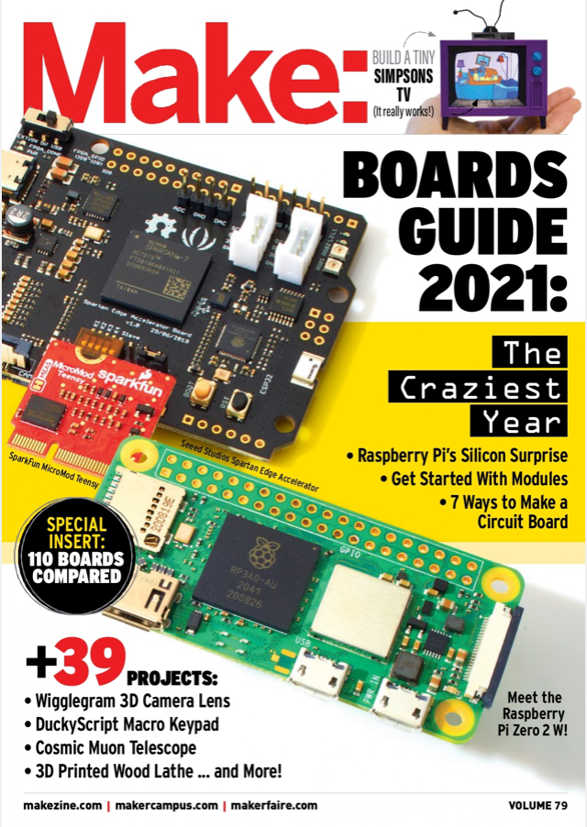

Make: magazine’s annual guide to boards
https://makezine.com/comparison/boards/
Notes:
Great hobby magazine. Clever people contribute to this.
Annual guide to boards (it's the buyer's guide to the landscape of boards). Website also has this.

Slide 25
Microcontroller “ecosystems”
Lots of sources for processor chips and development boards. But a good design depends on more that just a good set of chip specifications, or a low price.
You will also need many of these:
Development / evaluation boards
Language support (C, C++, Micropython)
Debuggers, emulators (more sophisticated than Arduino)
Real time operating system (RTOS)
Device drivers, APIs, examples
Data sheets and application notes
Developer community, field application engineers
Notes:
If you want to do a microcontroller project (89-90, etc), there is a lot of sources that want to sell you their very specific board.
When you commit to buying a chip you are buying into the entire ecosystem. A good design depends on more than just the chip (and timers etc). You need the ecosystem, for example the prototyping support.
A lot of boards sell evaluation boards on which you can prototype without having to solder your circuits etc. Evaluation boards are designed to help customers evaluate their boards.
An evaluation board is (generally) a basic system built around some specific part, along with all the other stuff you need to get that part to work. Sometimes you'll find one built around a technique, rather than a part. (Maybe there is a "respiratory inductive plethysmography evaluation board", but I doubt it.)
For example, an evaluation board for a CPU would typically have that CPU, some RAM, an SD card slot so you can insert your code, some USB ports, some PCI Express slots, an Ethernet port, a header for GPIO/I2C/SPI pins, and perhaps also a VGA port.
Once you stick all these pieces together, and write the software, and it works, you can produce your own circuit board with all the chips on it, and all the connections, because customers won't buy a pile of separate circuit boards and doo-dads duct-taped together. Your circuit board would have the CPU, memory, power supply, sensors, and everything else, on the one board. And then you can connect a battery to it (just a battery, not a USB power bank, because all the other circuitry is on your circuit board), put it inside a neat plastic case and sell it to people.
And evaluation boards are all different, depending on what they're designed to help you evaluate. Asking "which evaluation board can I use?" is a bit like asking "which circuit board should I use?". Don't look directly for evaluation boards - look for a part you want to have, then look for evaluation boards which have that part or a similar one. Often the part is simple enough that you don't need an evaluation board, so don't get hung up on evaluation boards either. It might be useful to collaborate with someone who has some hardware design experience.
Need language support: is there a good compiler?
Do they have debuggers? We haven't used this in this class but will be important as you move on. Step-through your code. There is none for the Arduino. But there are other boards made by other companies that you an plug debutters into. Or emulators, that is a piece of software that pretends to be your chip.
Do you want a real operating system? In our class we are writing bare-metal C. Bit banging and stuff. We are running one thing at a time. This teaches you a lot. Bit trend: RTOS which is the compromise between the convenience of a real OS like Linux and the precision of being able to operate in real time. An OS schedules all the different tasks that have to happen. You don't have any control over what happens when. So you are at the mercy of the OS. A RTOS is designed to keep multiple balls in the air but with precise timing that you have control over.
You cannot run an RTOS on an Arduino but you can run it on a bigger microcontroller.
Device drivers: Adafruit has them for all of their boards (either in Arduino or circuit python). You want that for development! Also want good data sheets and application notes. You want a good developer community and field application engineers that help you use the company's parts and help you solve your problems. You want to know the company is there for you if you need help.

